Slide 1
Machine Learning
Jason Tseng
Information Engineering, KSU

Slide 2
Machine Learning Algorithms
Classification: predict class from observations or classify a document into a predicted category, e.g. documents can be text, images
Regression: predict value or responses, which are continues numerical values from observations
Clustering: group observations into “meaningful” groups to find similarity as well as the relationship patterns among data samples

Slide 3
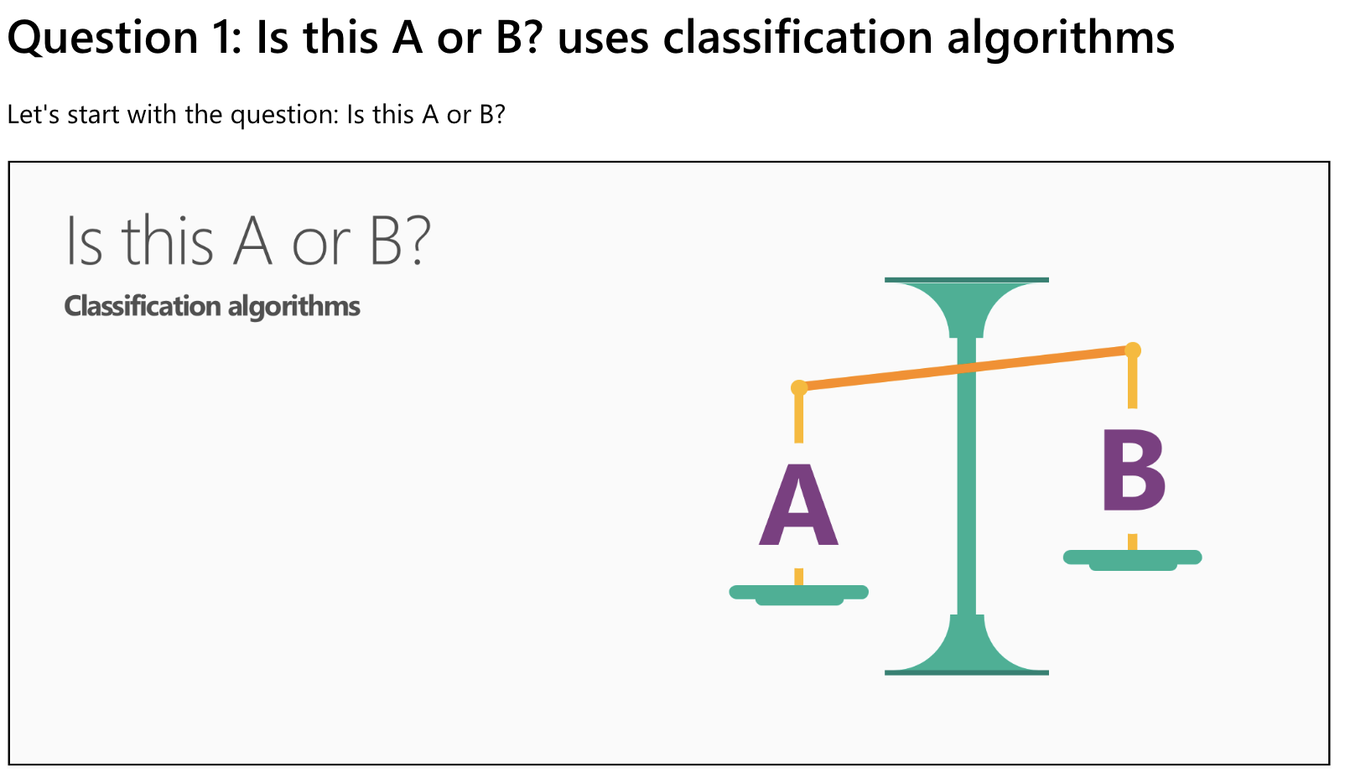
Machine Learning Algorithms - Classifications
Mathematically, classification is the task of approximating a mapping function (f) from input variables (X) to output variables (Y). It basically belongs to the supervised machine learning in which targets are also provided along with the input data set.
The categorized output can have the form such as “Black” or “White” or “spam” or “no spam”. An example of classification problem can be the spam detection in emails. Hence this is a binary type classification.

Slide 4
Machine Learning Algorithms - Classifications
Two types of learners in respective to classification problems −
Lazy Learners
As the name suggests, such kind of learners waits for the testing data to be appeared after storing the training data. Classification is done only after getting the testing data.
They spend less time on training but more time on predicting. Examples of lazy learners are K-nearest neighbor (KNN) and case-based reasoning.
Eager Learners
As opposite to lazy learners, eager learners construct classification model without waiting for the testing data to be appeared after storing the training data.
They spend more time on training but less time on predicting. Examples of eager learners are Decision Trees, Naïve Bayes and Artificial Neural Networks (ANN).

Slide 5
Various ML Classification Algorithms
The followings are some important ML classification algorithms :
Logistic Regression
Support Vector Machine (SVM)
Decision Tree
Naïve Bayes
Random Forest

Slide 6
Applications
Some of the most important applications of classification algorithms are as follows −
Speech Recognition
Handwriting Recognition
Biometric Identification
Document Classification

Slide 7
Classifications-Steps
Step1 :
Train the program (Building a Model) using a training set with a category for e.g. sports, cricket, news,
Classifier will compute probability for each word, the probability that it makes a document belong to each of considered categories
Step2 : Test with a test data set against this Model

Slide 8
Building a Classifier in Python
Step 1: Importing necessary python package:
import sklearn
Step 2: Importing and loading dataset:
sklearn’s Breast Cancer Wisconsin Diagnostic Database
Step 3: Organizing data into training & testing sets
divide our dataset into two parts: a training set and a test set.
Step 4: Model evaluation:
Naïve Bayes algorithm: Gaussian NB (http://en.wikipedia.org/wiki/Naive_Bayes_classifier)
Initialize, training, predicting
Step 5: Finding accuracy:
Comparison with test sets
Are we done for ML?
→Classification Evaluation Metrics

Slide 9
Classification Evaluation Metrics
How effective is our model ?
There can be different evaluation metrics, but we must choose it carefully because the choice of metrics influences how the performance of a machine learning algorithm is measured and compared.
Important classification evaluation metrics:
Confusion Matrix − It is the easiest way to measure the performance of a classification problem where the output can be of two or more type of classes.

Slide 10
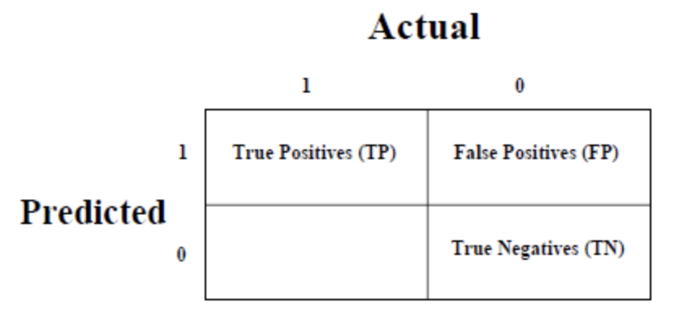
Confusion Matrix
A confusion matrix is nothing but a table with two dimensions viz. “Actual” and “Predicted” and furthermore, both the dimensions have “True Positives (TP)”, “True Negatives (TN)”, “False Positives (FP)”, “False Negatives (FN)” as shown below
True Positives (TP) − It is the case when both actual class & predicted class of data point is 1.
True Negatives (TN) − It is the case when both actual class & predicted class of data point is 0.
False Positives (FP) − It is the case when actual class of data point is 0 & predicted class of data point is 1.
False Negatives (FN) − It is the case when actual class of data point is 1 & predicted class of data point is 0.

Slide 11
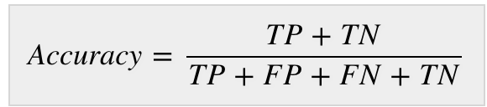
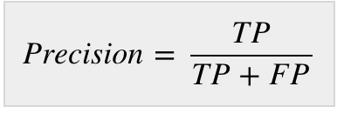
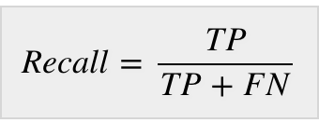
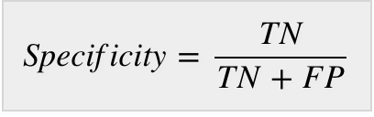
Confusion Matrix
Accuracy: defined as the number of correct predictions made by our ML model.
Precision: defined as the number of correct documents returned by our ML model.
Recall or Sensitivity: defined as the number of positives returned by our ML model.
Specificity: contrast to recall, may be defined as the number of negatives returned by our ML model.

Slide 12
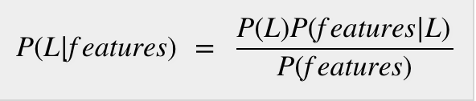
Classification Algorithms - Naïve Bayes algorithm
Bon applying Bayes’ theorem with a strong assumption that all the predictors are independent to each other. i.e., the assumption is that the presence of a feature in a class is independent to the presence of any other feature in the same class. E.g. , a phone may be considered as smart if it is having touch screen, internet facility, good camera etc. Though all these features are dependent on each other, they contribute independently to the probability of that the phone is a smart phone.
In Bayesian classification, the main interest is to find the posterior probabilities i.e. the probability of a label given some observed features,𝑃(𝐿 | 𝑓𝑒𝑎𝑡𝑢𝑟𝑒𝑠).
(𝐿 | 𝑓𝑒𝑎𝑡𝑢𝑟𝑒𝑠): posterior probability of class.
𝑃(𝐿): prior probability of class.
𝑃(𝑓𝑒𝑎𝑡𝑢𝑟𝑒𝑠|𝐿): the probability of predictor given class.
𝑃(𝑓𝑒𝑎𝑡𝑢𝑟𝑒𝑠): prior probability of predictor.

Slide 13
Building model using Naïve Bayes in Python
Three types of Naïve Bayes model under Scikit learn Python library:
Gaussian Naïve Bayes:
It is the simplest Naïve Bayes classifier having the assumption that the data from each label is drawn from a simple Gaussian distribution.
Multinomial Naïve Bayes:
Multinomial Naïve Bayes’ features are assumed to be drawn from a simple Multinomial distribution. Such kind of Naïve Bayes are most appropriate for the features that represents discrete counts.
Bernoulli Naïve Bayes:
Bernoulli Naïve Bayes’ features are assumed to be binary (0s and 1s). Text classification with ‘bag of words’ model can be an application of Bernoulli Naïve Bayes.

Slide 14
Advantages/Pros
Some pros of using Naïve Bayes classifiers −
Naïve Bayes classification is easy to implement and fast.
It will converge faster than discriminative models like logistic regression.
It requires less training data.
It is highly scalable in nature, or they scale linearly with the number of predictors and data points.
It can make probabilistic predictions and can handle continuous as well as discrete data.
Naïve Bayes classification algorithm can be used for binary as well as multi-class classification problems both.

Slide 15
Disadvantages/cons
Some cons of using Naïve Bayes classifiers −
One of the most important cons of Naïve Bayes classification is its strong feature independence because in real life it is almost impossible to have a set of features which are completely independent of each other.
Another issue with Naïve Bayes classification is its ‘zero frequency’ which means that if a categorial variable has a category but not being observed in training data set, then Naïve Bayes model will assign a zero probability to it and it will be unable to make a prediction.

Slide 16
Applications of Naïve Bayes classification
Some common applications of Naïve Bayes classification −
Real-time prediction − Due to its ease of implementation and fast computation, it can be used to do prediction in real-time.
Multi-class prediction − Naïve Bayes classification algorithm can be used to predict posterior probability of multiple classes of target variable.
Text classification − Due to the feature of multi-class prediction, Naïve Bayes classification algorithms are well suited for text classification. That is why it is also used to solve problems like spam-filtering and sentiment analysis.
Recommendation system − Along with the algorithms like collaborative filtering, Naïve Bayes makes a Recommendation system which can be used to filter unseen information and to predict weather a user would like the given resource or not.

